Slide 1

Predictive Learning from Data
LECTURE SET 2
Problem Setting, Basic Learning Problems and Inductive Principles
Electrical and Computer Engineering

Slide 2
OUTLINE
2.0 Objectives + Background
- formalization of inductive learning
- classical statistics vs predictive approach
2.1 Terminology and Learning Problems
2.2 Basic Learning Methods and Complexity Control
2.3 Inductive Principles
2.4 Alternative Learning Formulations
2.5 Summary

Slide 3
2.0 Objectives
- To quantify the notions of explanation, prediction and model
- Introduce terminology
- Describe common learning problems
Past observations ~ data points
Explanation (model) ~ function
Learning ~ function estimation (from data)
Prediction ~using the model to predict new inputs

Slide 4
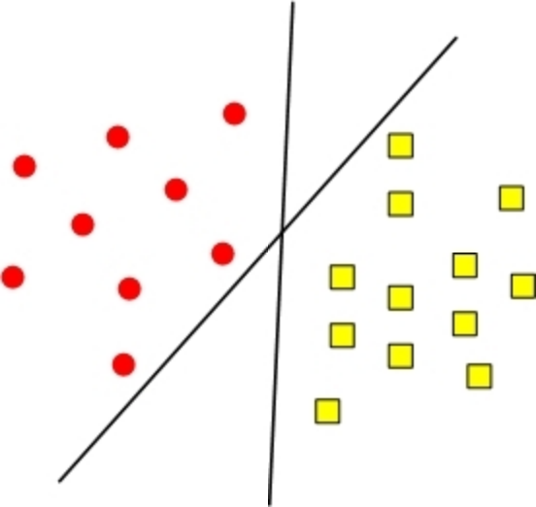
Example: classification problem
training samples, model
Goal 1: explanation of training data ~ ERM
Goal 2: generalization (for future data)
Learning (model estimation) is ill-posed

Slide 5

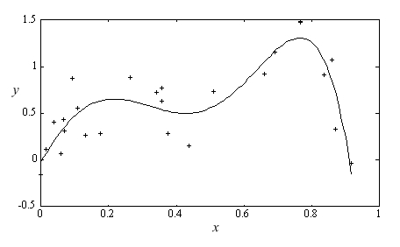
Goal: imitation of system’s output
Usual formalization ~ function estimation

Slide 6
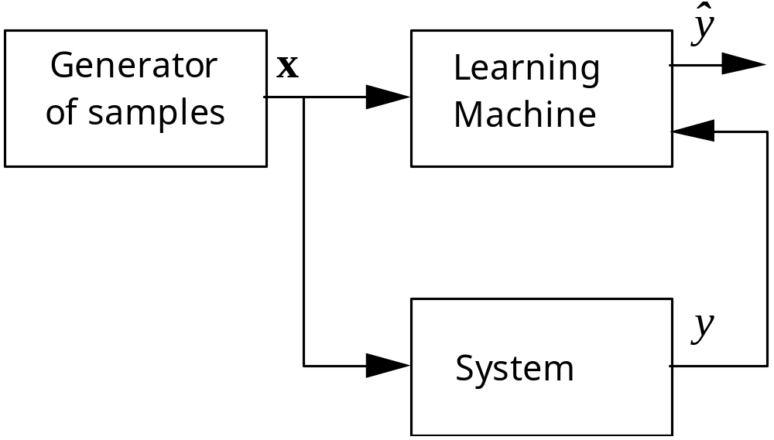
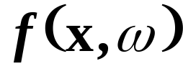
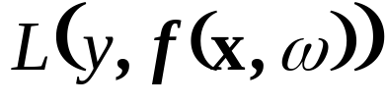
Mathematical formalization
Learning machine ~ predictive system
Unknown joint distribution P(x,y)
Set of functions (possible models)
Pre-specified Loss function
(by convention, non-negative L )

Slide 7
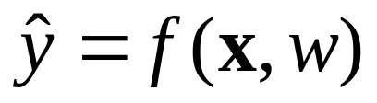

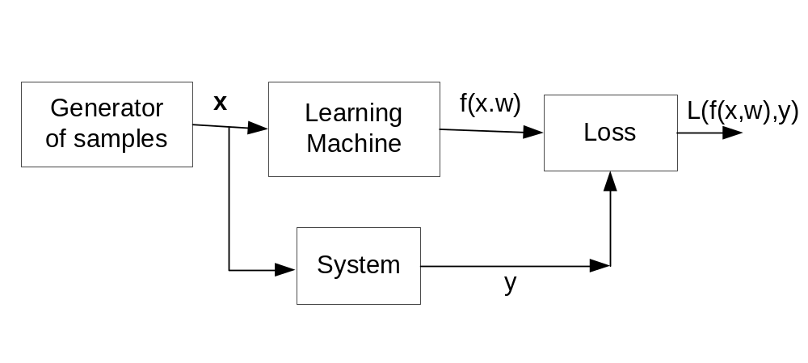
Inductive Learning Setting
The learning machine observes samples (x ,y), and returns an estimated response
Two modes of inference: identification vs imitation
Risk

Slide 8
Two Views of Empirical Inference
Two approaches to empirical or statistical inference
These two approaches are different both
technically/mathematically and philosophically
EMPIRICAL DATA
KNOWLEDGE,
ASSUMPTIONS
STATISTICAL INFERENCE
PROBABILISTIC MODELING
RISK-MINIMIZATION APPROACH

Slide 9
Classical Approaches to Inductive Inference
Generic problem: finite data → Model
(1) Classical Science ~ hypothesis testing
experimental data is generated by a given model (single function ~ scientific theory)
(2) Classical statistics ~ max likelihood
~ data generated by a parametric model for density.
Note: loss fct ~ likelihood (not problem-specific)
~The same solution approach for all types of problems
R. Fisher: “uncertain inferences” from finite data
see: R. Fisher (1935), The Logic of Inductive Inference, J. Royal Statistical Society, available at http://www.dcscience.net/fisher-1935.pdf

Slide 10
Summary and Discussion
Math formulation useful for quantifying
- explanation ~ fitting error (training data)
- generalization ~ prediction error
Natural assumptions
- future similar to past: stationary P(x,y), i.i.d.data
- discrepancy measure or loss function, i.e. MSE
What if these assumptions do not hold?

Slide 11
OUTLINE
2.0 Objectives
2.1 Terminology and Learning Problems
- supervised/ unsupervised
- classification
- regression etc.
2.2 Basic Learning Methods and Complexity Control
2.3 Inductive Principles
2.4 Alternative Learning Formulations
2.5 Summary

Slide 12
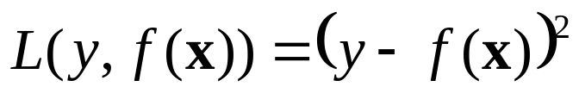
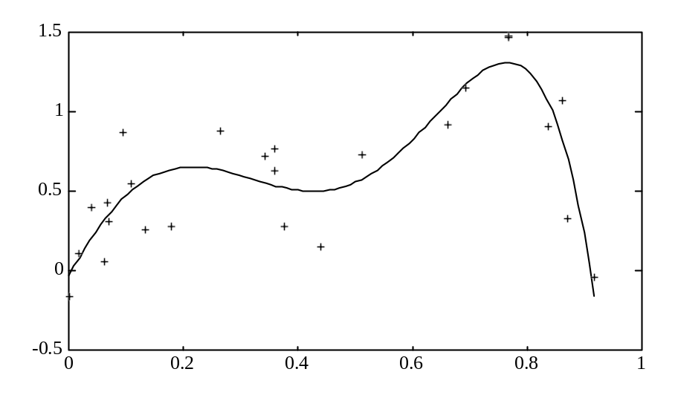
Supervised Learning: Regression
Data in the form (x,y), where
- x is multivariate input (i.e. vector)
- y is univariate output (‘response’)
Regression: y is real-valued
→ Estimation of real-valued function

Slide 13
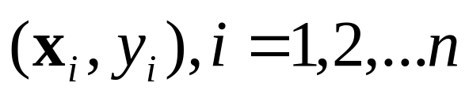

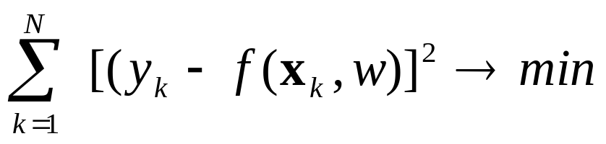

Regression Estimation Problem
Given: training data
Find a function that minimizes squared
error for a large number (N) of future samples:
BUT future data is unknown ~ P(x,y) unknown
→ All estimation problems are ill-posed

Slide 14
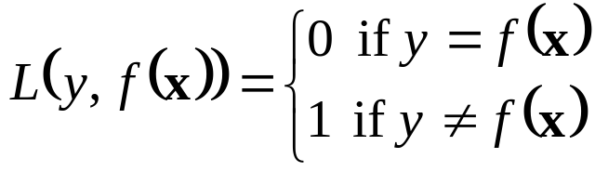
Supervised Learning: Classification
Data in the form (x,y), where
- x is multivariate input (i.e. vector)
- y is univariate output (‘response’)
Classification: y is categorical (class label)
→ Estimation of indicator function

Slide 15
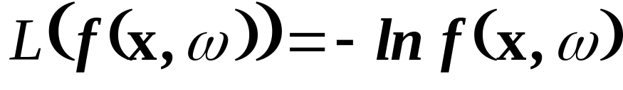
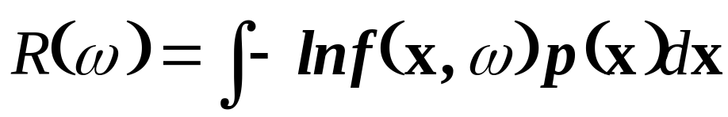
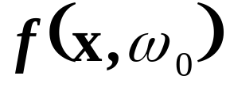
Density Estimation
Data in the form (x), where
- x is multivariate input (feature vector)
Parametric form of density is given:
The loss function is likelihood or, more common, the negative log-likelihood
The goal of learning is minimization of
from finite training data, yielding

Slide 16
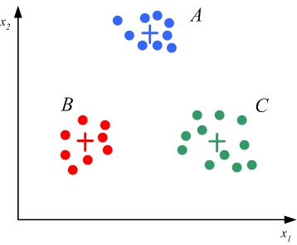
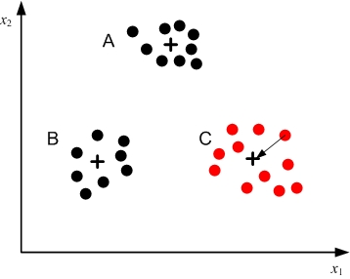
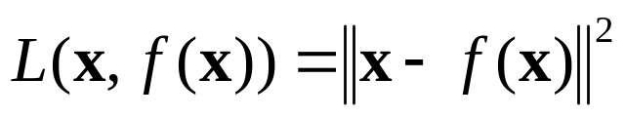

Unsupervised Learning 1
Data in the form (x), where
- x is multivariate input (i.e. feature vector)
Goal: data reduction or clustering
→ Clustering = estimation of mapping X→ C, where and

Slide 17
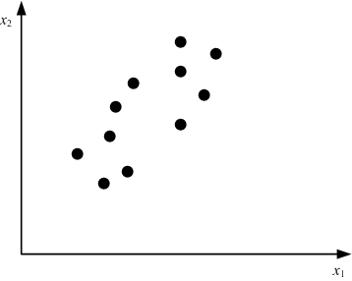
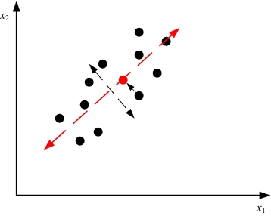
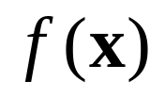
Unsupervised Learning 2
Data in the form (x), where
- x is multivariate input (i.e. vector)
Goal: dimensionality reduction
Mapping is projection of the data onto low-dimensional subspace, minimizing loss

Slide 18
OUTLINE
2.0 Objectives
2.1 Terminology and Learning Problems
2.2 Basic Learning Methods and Complexity Control
- Parametric modeling
- Non-parametric modeling
- Data reduction
- Complexity control
2.3 Inductive Principles
2.4 Alternative Learning Formulations
2.5 Summary

Slide 19
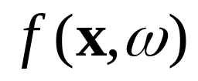


Basic learning methods
General idea
Specify a wide set of possible models
where is an abstract set of ‘parameters’
Estimate model parameters by minimizing given loss function for training data (~ ERM)
Learning methods differ in
Chosen parameterization
Loss function used
Optimization method used for parameter estimation

Slide 20
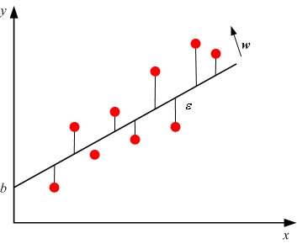
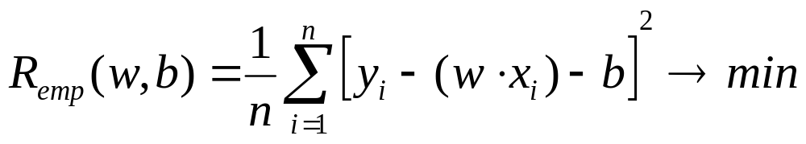
Parametric Modeling (~ERM)
Given training data
(1) Specify parametric model
(2) Estimate its parameters (via fitting to data)
Example: Linear regression F(x)= (w x) + b

Slide 21
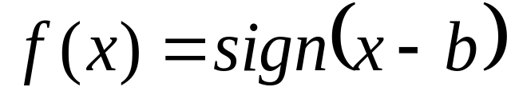
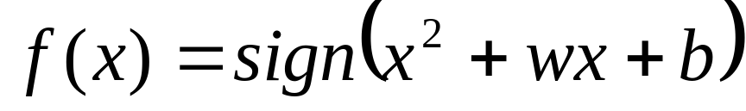
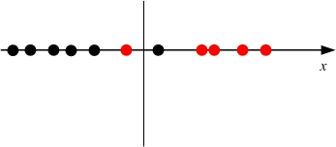
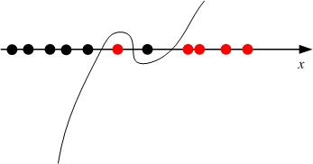
Parametric Modeling: classification
Given training data
(1) Specify parametric model
Estimate its parameters (via fitting to data)
Example: univariate classification data set
(a) Linear decision boundary (b) third-order polynomial

Slide 22
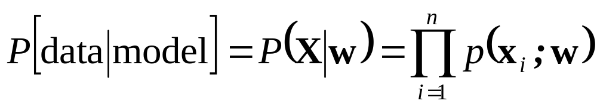
Parametric Methods in Statistics
• Goal of learning : density estimation
Maximum Likelihood principle:
Given training data X, find w* maximizing
equivalently, minimize negative log-likelihood
See examples in the textbook, Section 2.2

Slide 23

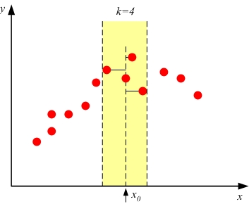
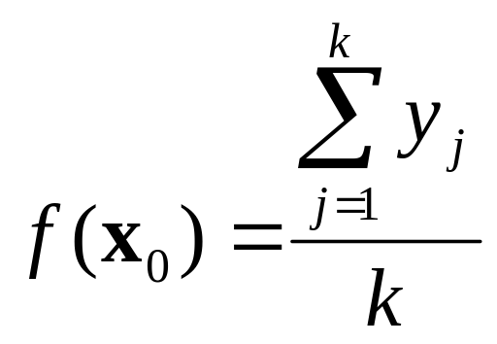
Non-Parametric Modeling
Given training data
Estimate the model (for given ) as
‘local average’ of the data.
Note: need to define ‘local’, ‘average’
Example: k-nearest neighbors regression

Slide 24
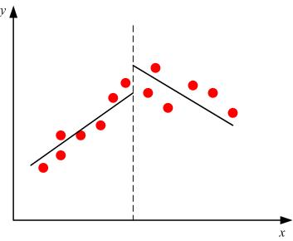
Data Reduction Approach
Given training data, estimate the model as ‘compact encoding’ of the data.
Note: ‘compact’ ~ # of bits to encode the model
or # of bits to encode the data (MDL)
Example: piece-wise linear regression
How many parameters needed
for two-linear-component model?

Slide 25
Data Reduction Approach (cont’d)
Data Reduction approaches are commonly used for unsupervised learning tasks.
Example: clustering.
Training data encoded by 3 points (cluster centers)
Issues:
How to find centers?
How to select the number of clusters?
H

Slide 26
Diverse terminology (for learning methods)
Many methods differ in parameterization of admissible models or approximating functions
- neural networks
- decision trees
- signal processing (~ wavelets)
How training samples are used:
Batch methods
On-line or flow-through methods

Slide 27
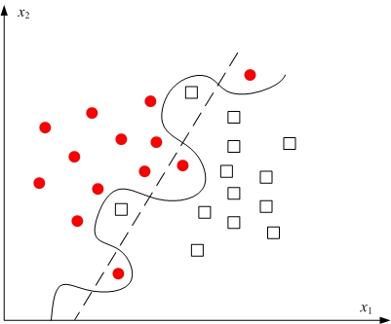
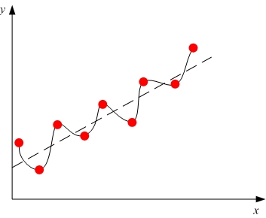
Motivation for Complexity Control
Effect of model control on generalization
(a) Classification (b) Regression

Slide 28

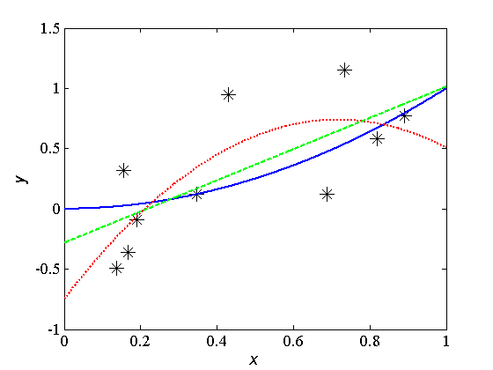
Complexity Control: parametric modeling
Consider regression estimation
Ten training samples
Fitting linear and 2-nd order polynomial:

Slide 29
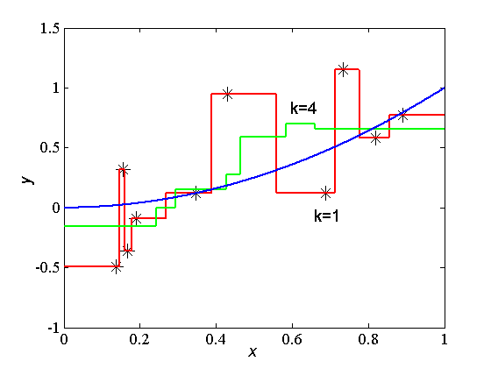
Complexity Control: local estimation
Consider regression estimation
Ten training samples from
Using k-nn regression with k=1 and k=4:

Slide 30
Complexity Control (summary)
Complexity (of admissible models) affects generalization (for future data)
Specific complexity indices for
  Parametric models: ~ # of parameters
  Local modeling: size of local region
  Data reduction: # of clusters
Complexity control = choosing optimal complexity (~ good generalization) for given (training) data set
not well-understood in classical statistics

Slide 31
OUTLINE
2.0 Objectives
2.1 Terminology and Learning Problems
2.2 Basic Learning Methods and Complexity Control
2.3 Inductive Principles
- Motivation
- Inductive Principles: Penalization, SRM, Bayesian Inference, MDL
2.4 Alternative Learning Formulations
2.5 Summary

Slide 32
Conceptual Motivation
• Generalization from finite data requires:
a priori knowledge = any info outside training data, e.g. ???
inductive principle = how to combine a priori knowledge with training data
learning method = constructive implementation of inductive principle
• Example: Empirical Risk Minimization ~ parametric modeling approach
Question: what may be wrong with ERM?

Slide 33

Motivation (cont’d)
• Need for flexible (adaptive) methods
- wide (~ flexible) parameterization
→ ill-posed estimation problems
- need provisions for complexity control
• Inductive Principles originate from
statistics, applied math, info theory, learning theory – and they adopt distinctly different terminology & concepts

Slide 34
Empirical Inference
Two approaches to empirical or statistical inference
General strategies for obtaining good models from data
~ known as inductive principles in learning theory
EMPIRICAL DATA
KNOWLEDGE,
ASSUMPTIONS
STATISTICAL INFERENCE
PROBABILISTIC MODELING
RISK-MINIMIZATION APPROACH

Slide 35
Inductive Principles
• Inductive Principles differ in terms of
- representation of a priori knowledge
- mechanism for combining a priori knowledge with training data
- applicability when the true model does not belong to admissible models
- availability of constructive procedures (learning methods/ algorithms)
Note: usually prior knowledge about parameterization

Slide 36
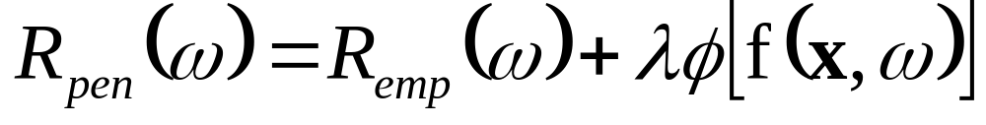
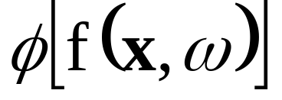

PENALIZATION
• Overcomes the limitations of ERM
Penalized empirical risk functional
is non-negative penalty functional specified a priori (independent of the data); its larger values penalize complex functions.
is regularization parameter (non-negative number) tuned to training data
Example: ridge regression

Slide 37
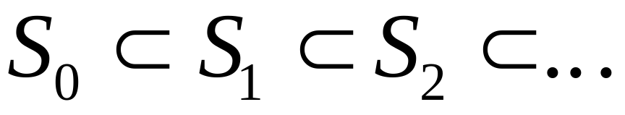
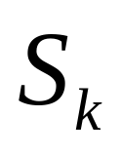
Structural Risk Minimization
• Overcomes the limitations of ERM
Complexity ordering on a set of admissible models, as a nested structure
Examples: a set of polynomial models, Fourier expansion etc.
Goal of learning ~ minimization of empirical risk for an optimally selected element

Slide 38
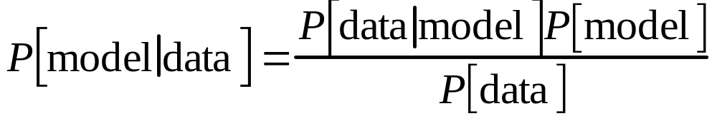
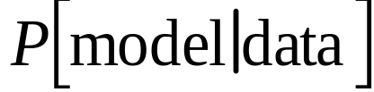

Bayesian Inference
• Probabilistic approach to inference
Explicitly defines a priori knowledge as prior probability (distribution) on a set of model parameters
Bayes formula for updating prior probability using the evidence given by training data:
~ posterior probability
~ likelihood (probability that the data are generated by a model)

Slide 39

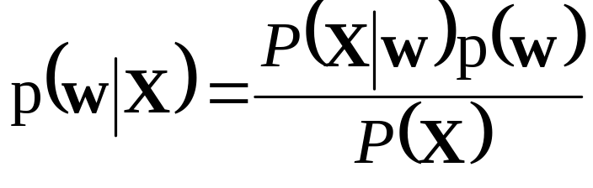
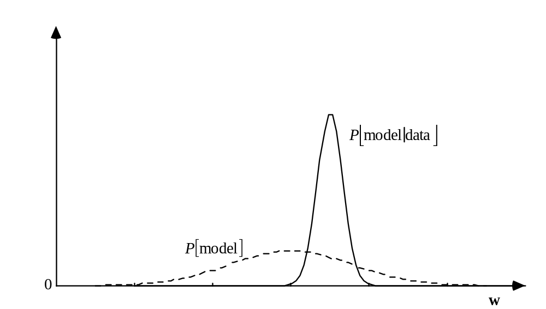
Bayesian Density Estimation
• Consider parametric density estimation where prior probability distribution
Given training data X, the posterior probability distribution is updated

Slide 40
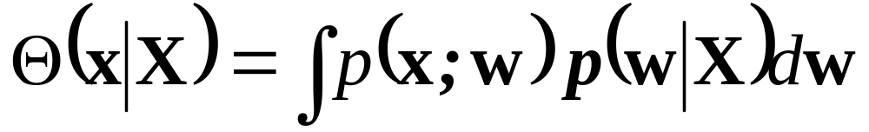
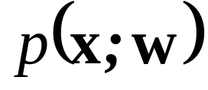
Implementation of Bayesian Inference
• Maximum Likelihood,i.e. choose w* maximizing
(equivalent to ERM)
True Bayesian inference (averaging)
Where is a set of admissible densities
and

Slide 41
Minimum Description Length (MDL)
• Information-theoretic approach
- any training data set can be optimally encoded
- code length ~ generalization capability
Related to the Data Reduction approach introduced (informally) earlier.
Two possible implementations:
- lossy encoding
- lossless encoding of the data (as in MDL)

Slide 42
Binary Classification under MDL
• Consider training data set
X={xk,yk} (k=1,2,...n) where y={0,1}
Given data object X={x1,..., xn} is a binary string y1,...,yn random?
if there is a dependency then the output string can be encoded by a shorter code:
- the model having code length L (model)
- the error term L( data | model)
→ the total length of such a code for string y is:
b = L (model) + L( data | model)
and the compression coefficient is K = b / n

Slide 43
Comparison of Inductive Principles
Representation of a priori knowledge/ complexity:
penalty term, structure , prior distribution, codebook
Formal procedure for complexity control:
penalized risk, optimal element of a structure, posterior distribution
Constructive implementation of complexity control:
resampling, analytic bounds, marginalization, minimum code length
***See Table 2.1 in [Cherkassky & Mulier, 2007]***

Slide 44
OUTLINE
2.0 Objectives
2.1 Terminology and Learning Problems
2.2 Basic Learning Methods and Complexity Control
2.3 Inductive Principles
2.4 Alternative Learning Formulations
- Motivation
- Examples of non-standard formulations
- Formalization of application domain
2.5 Summary

Slide 45
Motivation
Estimation of predictive model
Step 1: Problem specification/ Formalization
Step 2: Model estimation, learning, inference
Standard Inductive Formulation
- usually assumed in all ML algorithms
- certainly may not be the best formalization for given application problem

Slide 46
Assumptions for Inductive Learning
Available (training) data format (x,y)
Test samples (x-values) are unknown
Stationary distribution, i.i.d samples
Single model needs to be estimated
Specific loss functions adopted for common tasks (classification, regression etc.)

Slide 47
Non-standard Learning Settings
Available Data Format
- x-values of test samples are known
→ Transduction, semi-supervised learning
Different (non-standard) Loss Function
- see example ‘learning the sign of a function’
Univariate Output (~ a single model)
- multiple models may be estimated from available/training data

Slide 48
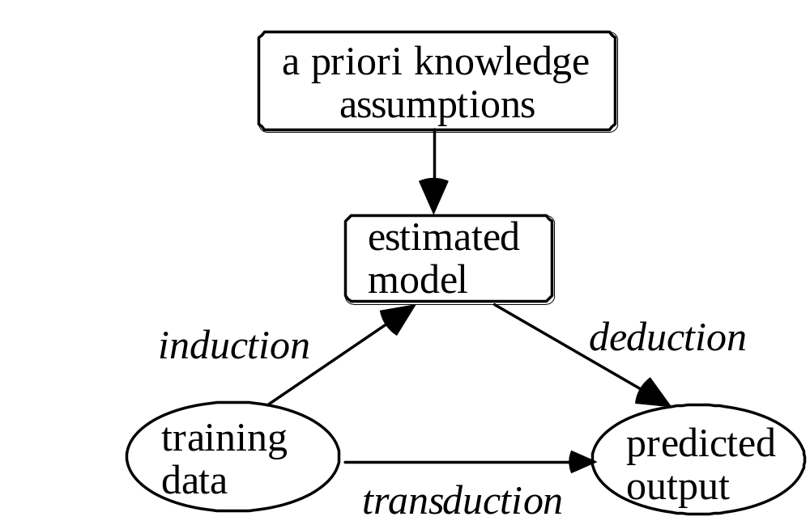
Transduction
~ predicting function values at given points:
Given labeled training set + x-values of test data
Estimate (predict) y-values for given test inputs

Slide 49
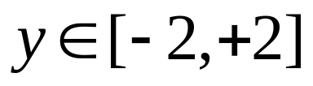
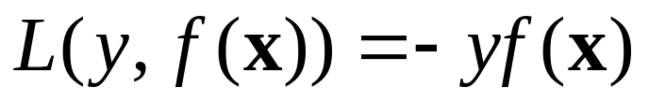
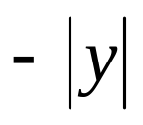

Learning sign of a function
Given training data
with y-values in a bounded range
Estimate function predicting sign of y
Loss function
If prediction is wrong ~ real-valued loss
If prediction is correct ~ real-valued gain
Neither standard regression, nor classification
Practical application: frequent trading

Slide 50

Multiple Model Estimation
Training data in the form (x,y), where
- x is multivariate input
- y is univariate real-valued output (‘response’)
Similar to standard regression, but subsets of data may be described by different models

Slide 51
Formalization of Application Problems
Problem Specification Step cannot be formalized
But
Several guidelines can be helpful during formalization process
Mapping process:
Application requirements → Learning formulation
Specific components of this mapping process are shown next

Slide 52


Slide 53
Summary
Standard Inductive Learning ~ function estimation
Goal of learning (empirical inference):
to act/perform well, not system identification
Important concepts:
- training data, test data
- loss function, prediction error (~ prediction risk)
- basic learning problems
Complexity control
Inductive principles – which one is the ‘best’ ?

Slide 54
Summary (cont’d)
Assumptions for inductive learning
Non-standard learning formulations
Aside: predictive modeling of
physical systems vs social systems
Note: main assumption (stationarity) does not hold in social systems (business data, financial data etc.)
For discussion think of example application that requires non-standard learning formulation
Note: (a) do not use examples similar to ones presented in my lectures and/or text book
(b) you can email your example to instructor (maximum half-a-page)

